Slide 1
PATIENT MANAGEMENT SYSTEM
Team Members
Dhanalakshmi V
Kavitha M
Kowsalya S
Nandhini P
INDUSTRY GUIDE FACULTY GUIDE
Mr. Sivaraj Mr. Ashok
Department of CSE, KGiSL Institute of Technology, Coimbatore

Slide 2
Abstract
Patient management system is a web based application.
It is mainly used to reduce manual registration work
To avoid waiting line at Reception.
It can be used for only second time visitors(patients)
Patients can access their medical records .
Department of CSE, KGiSL Institute of Technology, Coimbatore

Slide 3
Existing system
Patients do registration at admission counter with help of receptionist.
Appointment through phone call
Doctor availability verify by call
Patients medical details can access only by Doctor
Department of CSE, KGiSL Institute of Technology, Coimbatore

Slide 4
Proposed System
Advantages
It is a user friendly and easily accessible.
Reduce paperwork .
Patients medical records in digital format.
Doctor knows no of patient going to consult
Department of CSE, KGiSL Institute of Technology, Coimbatore
Notes:
When the patient enter their ph.no in screen automatically it send availability of patients to the doctor.

Slide 5
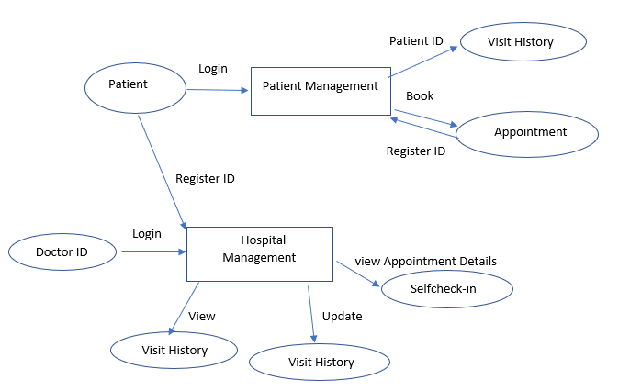
Data flow diagram-Level 0

Slide 6
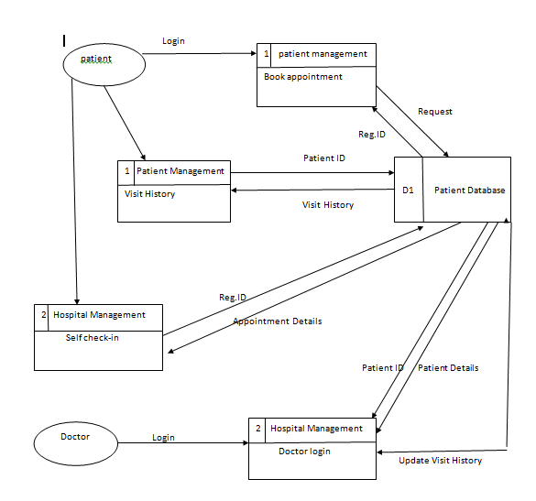
Data flow diagram-Level 1

Slide 7
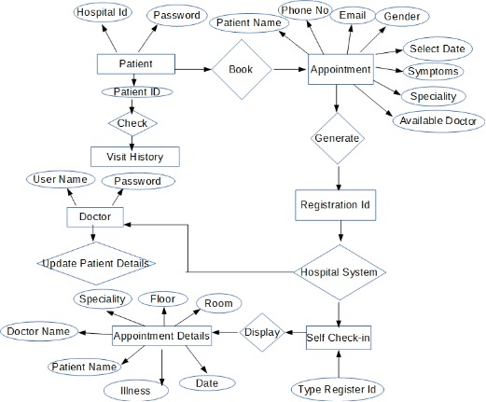
ER Diagram

Slide 8
Module Split-up
Request appointment with doctor
Self check-in
Visit history
Investigation history

Slide 9
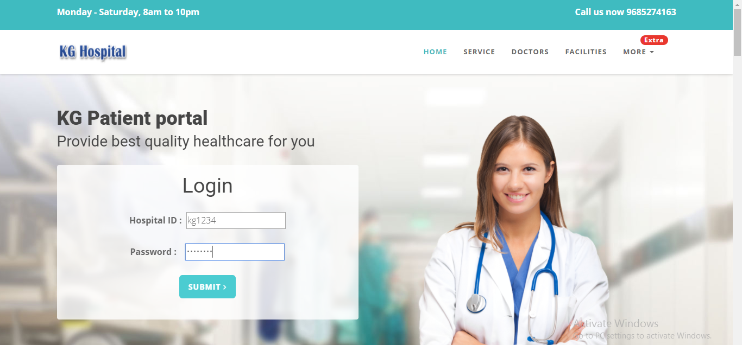
Screenshots

Slide 10
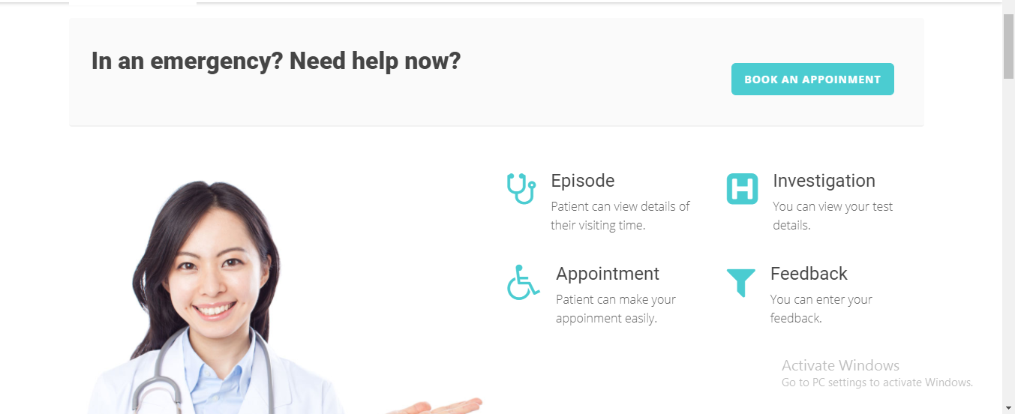

Slide 11
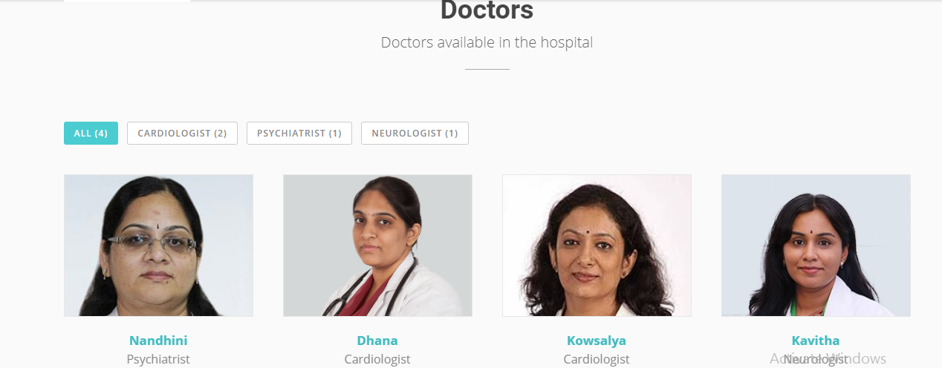

Slide 12
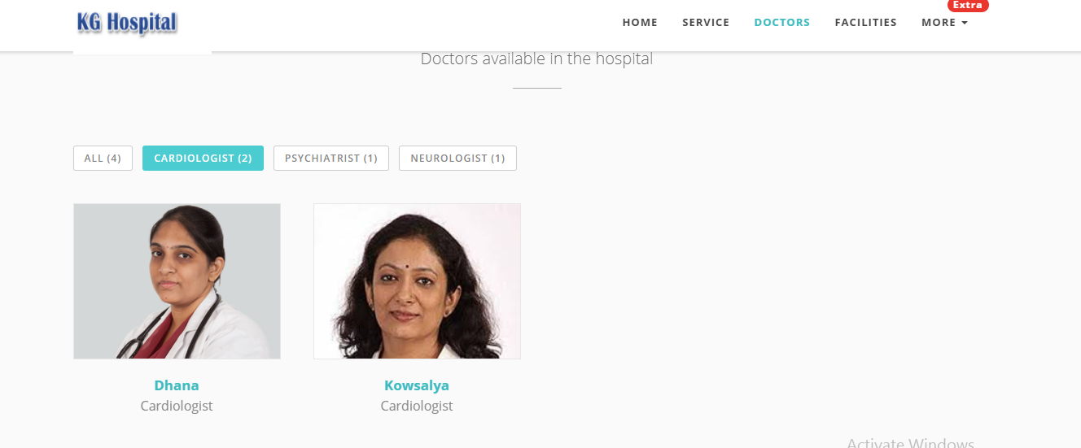

Slide 13
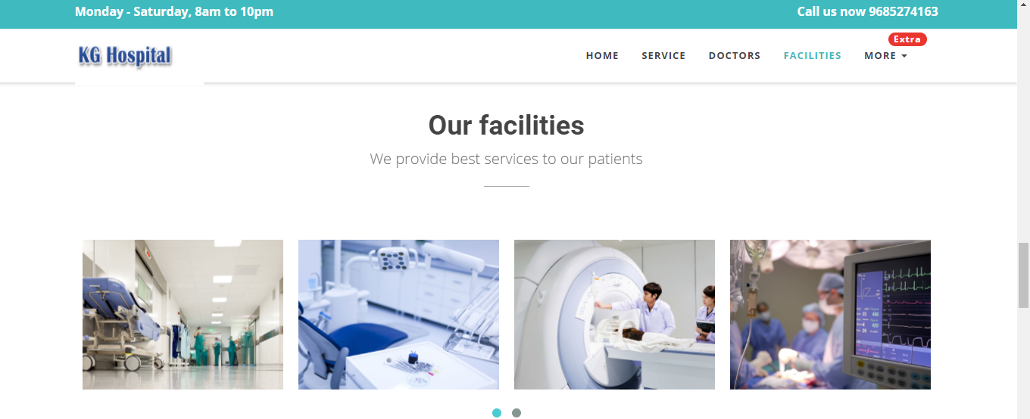

Slide 14
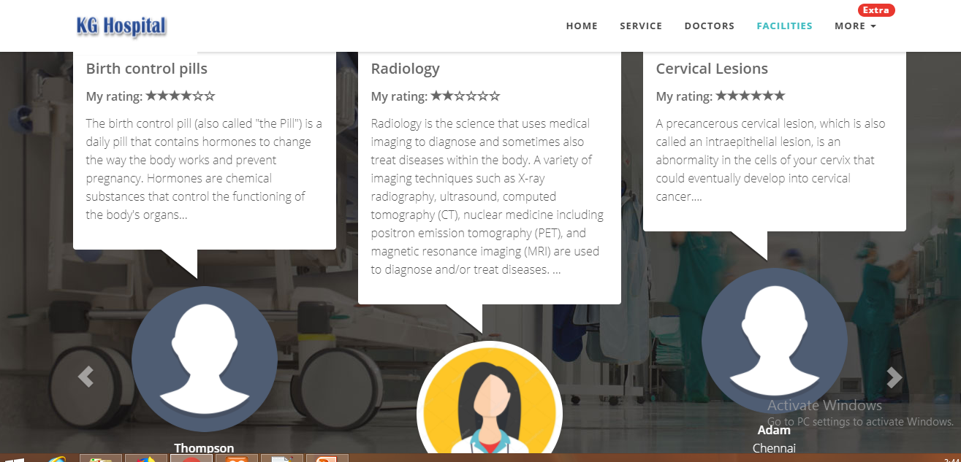

Slide 15
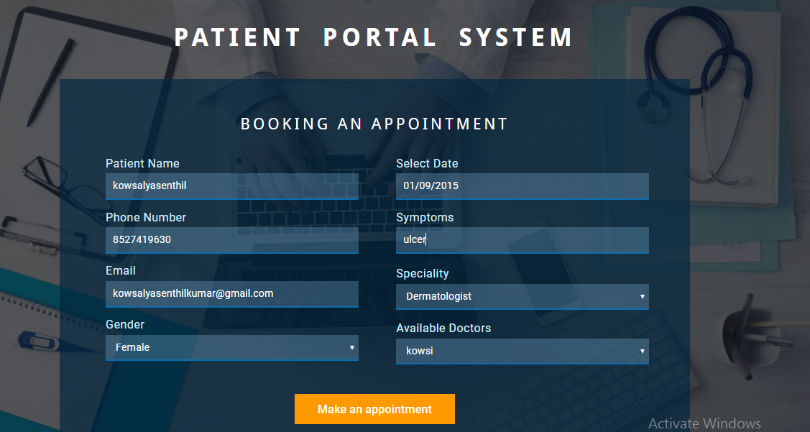

Slide 16
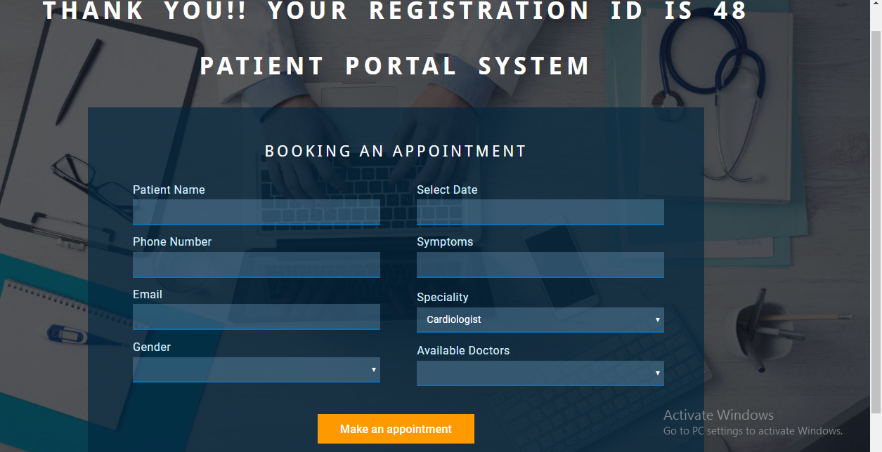

Slide 17
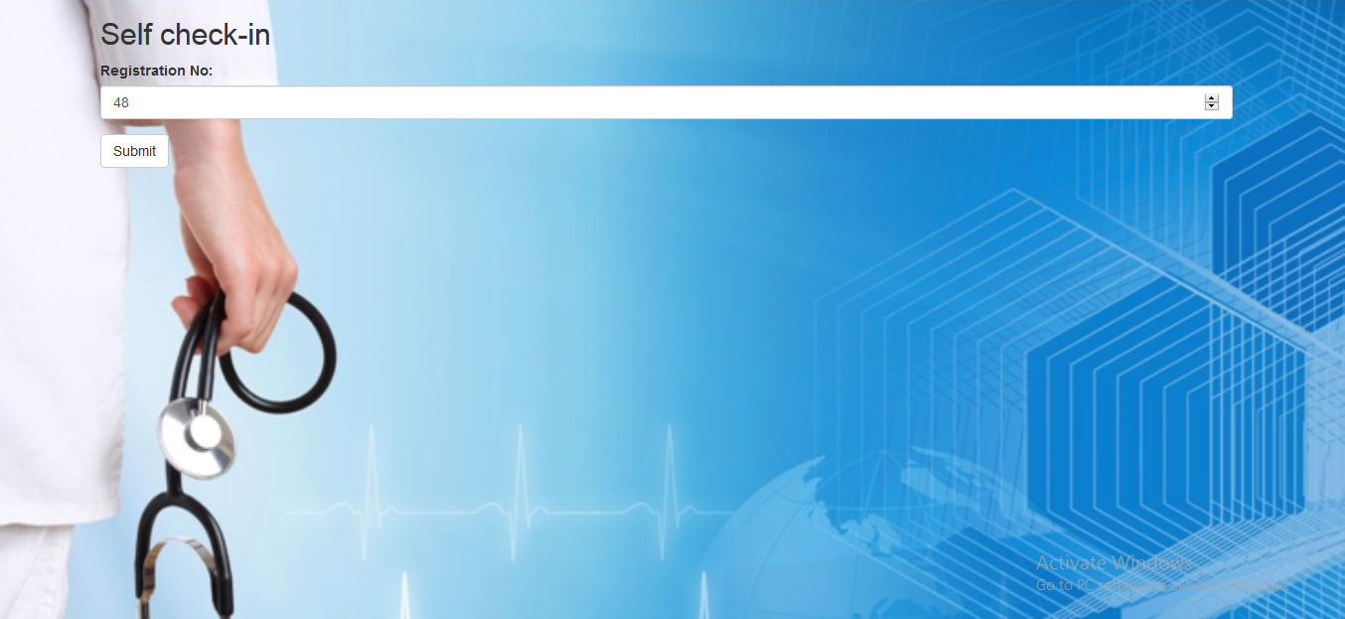

Slide 18
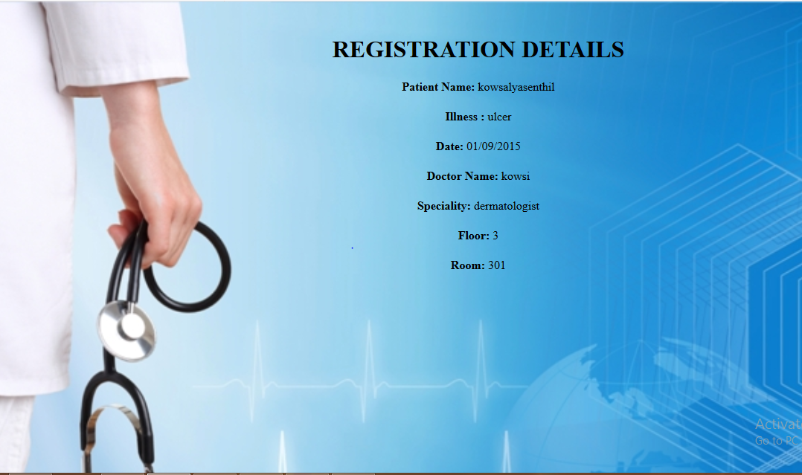

Slide 19
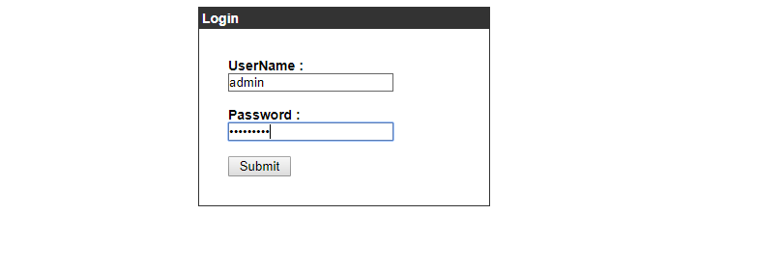

Slide 20
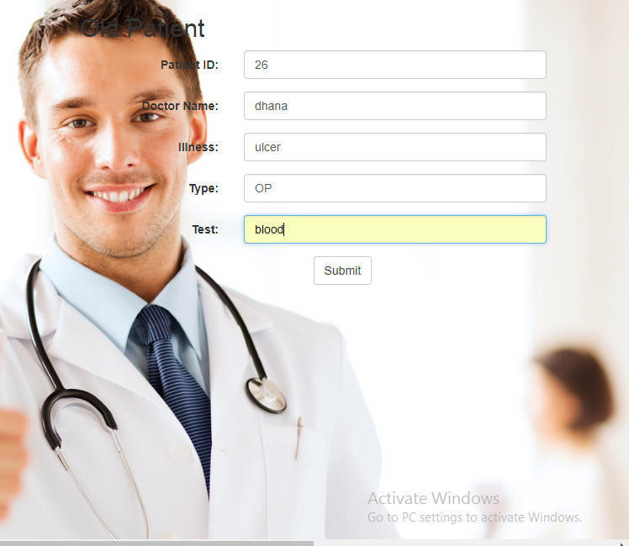

Slide 21
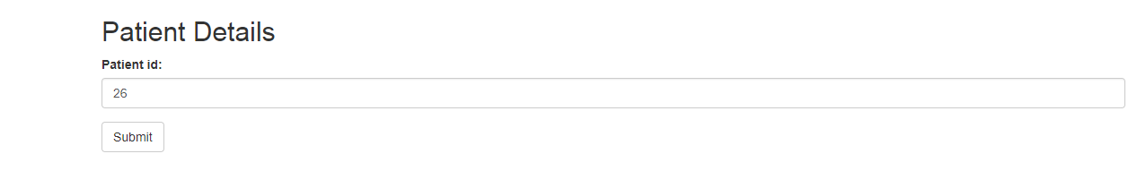

Slide 22
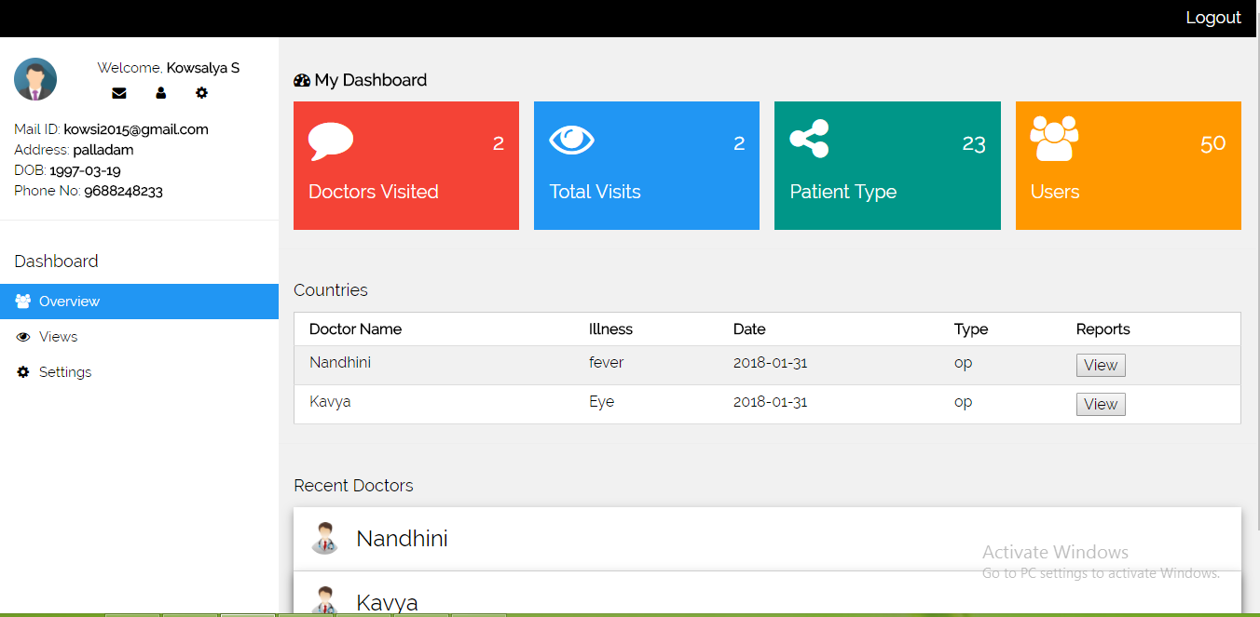

Slide 23
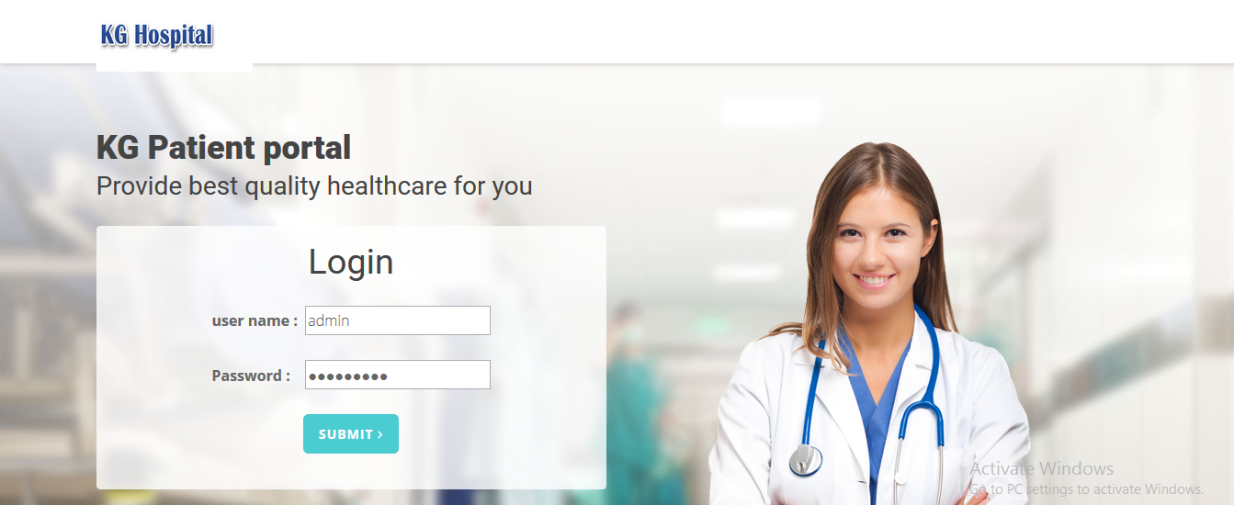

Slide 24
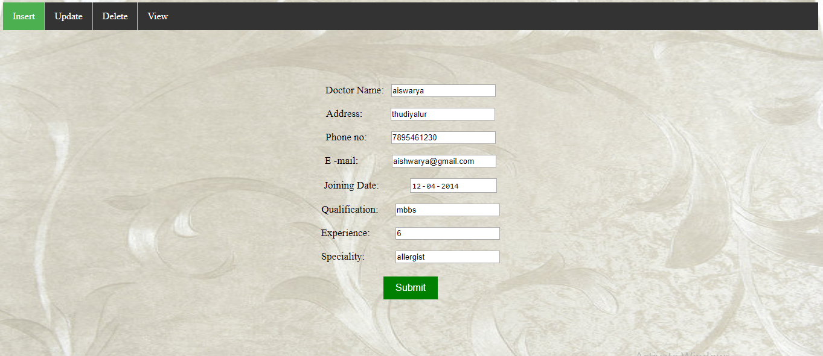

Slide 25
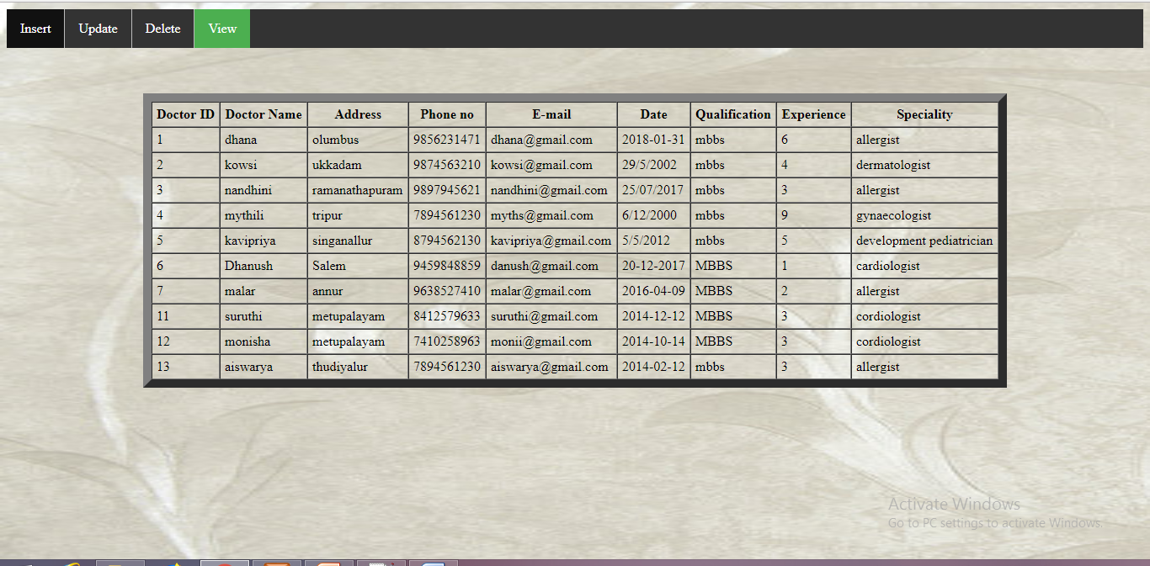

Slide 26
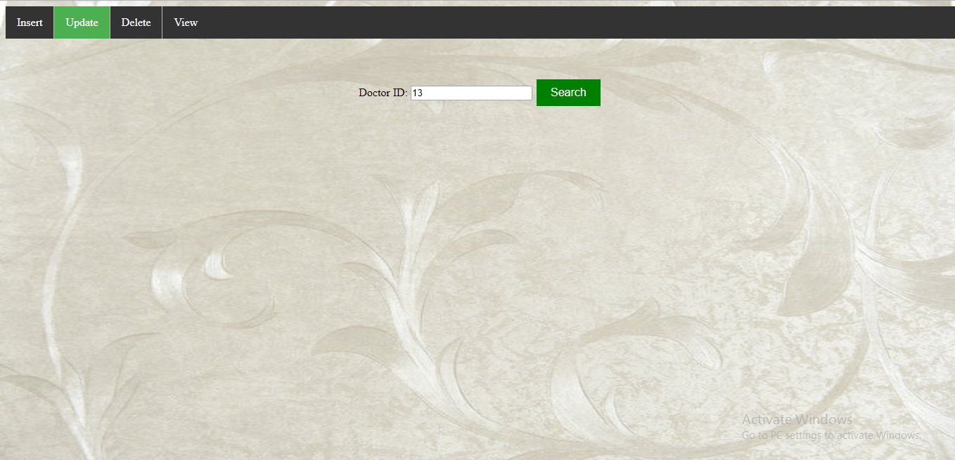

Slide 27
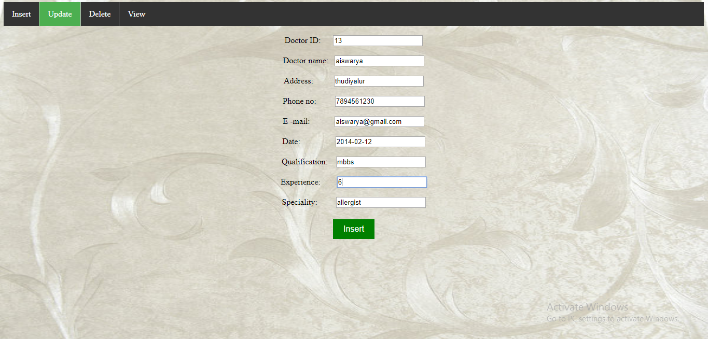

Slide 28
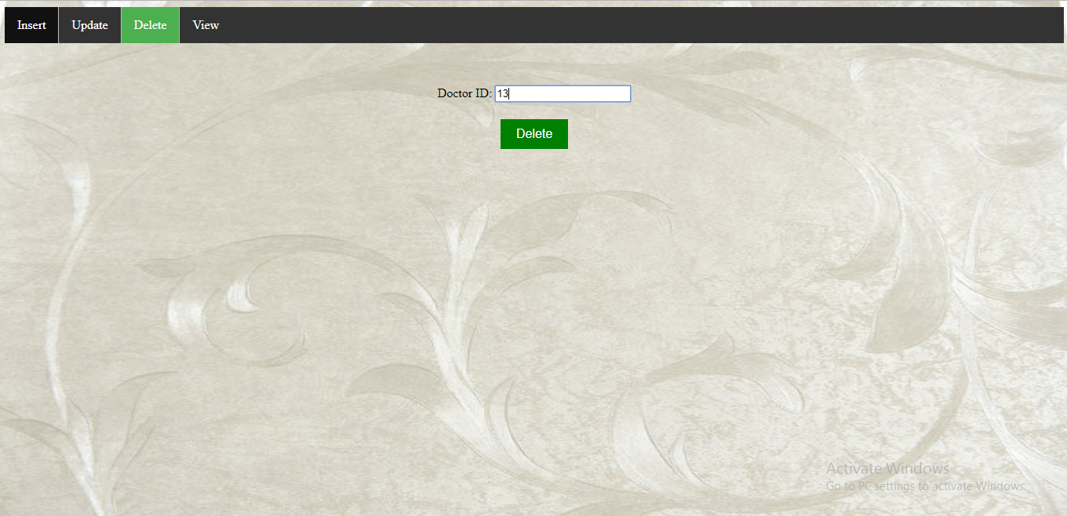

Slide 29
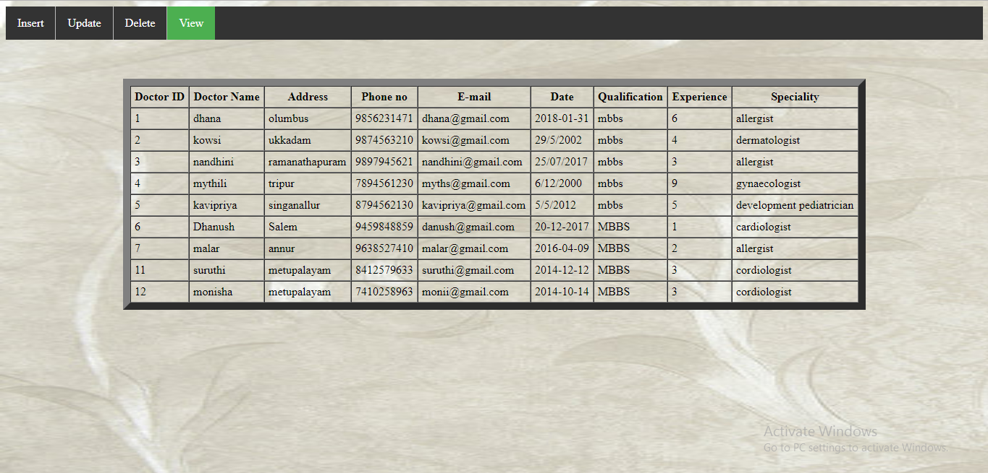

Slide 30
THANK YOU

